Slide 1
Numpy
Lingua franca for data exchange

Slide 2

Numpy
Numerical Python
Developed in 2005 by Travis Oliphant
Lingua franca for data exchange
ndarray – a n-dimensional array
Fast operations on entire arrays
Reading/writing array data
Linear algebra operations
Travis Oliphant

Slide 3
nd-array
A fast, flexible container for large datasets in Python
Homogeneous data i.e. all of the elements must be the same type

Slide 4
Creating ndarray
np.array(): convert input data to an ndarray
np.zeros(): produces arrays of 0s
np.ones(): produces arrays of 1s
np.empty(): create new arrays by allocating new memory, but do not populate with any values
np.arange(): like the built-in range but returns an ndarray instead of a list

Slide 5
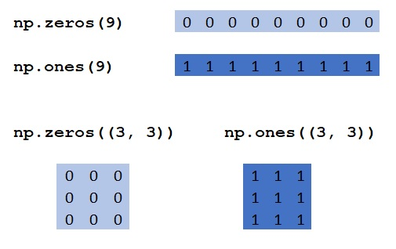
Examples

Slide 6
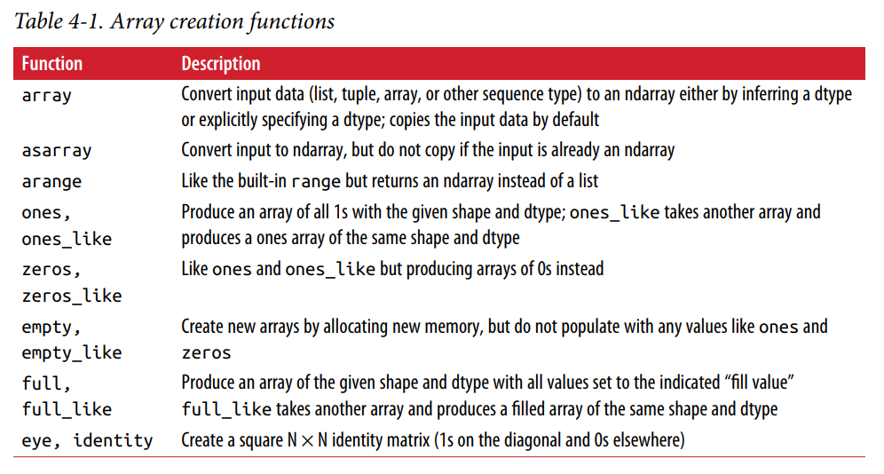
Summary of array creation functions

Slide 7
Attributes of numpy array
shape: a tuple indicating the size of each dimension
dtype: an object describing the data type of the array
ndim: the number of dimensions of the array

Slide 8
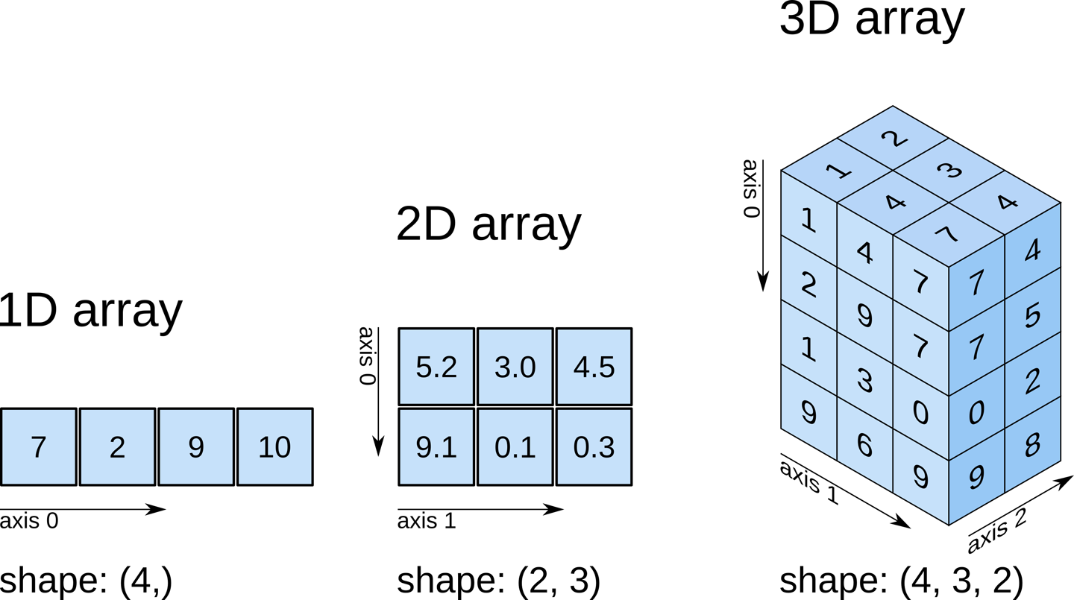
shape attribute

Slide 9
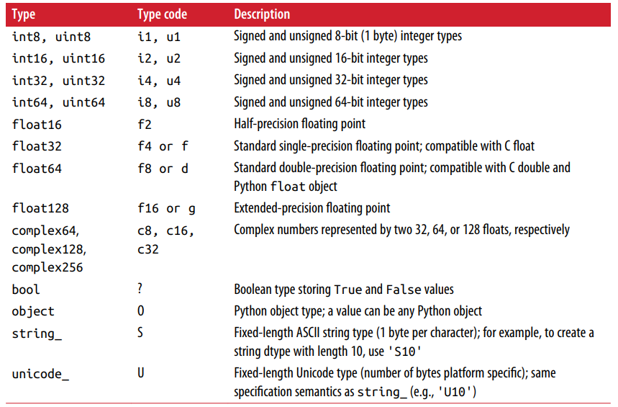
Numpy data types

Slide 10
Vectorization
Express batch operations on data without writing any for loops
Any arithmetic operations between equal-size arrays applies the operation element-wise
Arithmetic operations with scalars propagate the scalar argument to each element in the array
Comparisons between arrays of the same size yield boolean arrays
Operations between differently sized arrays is called broadcasting

Slide 11
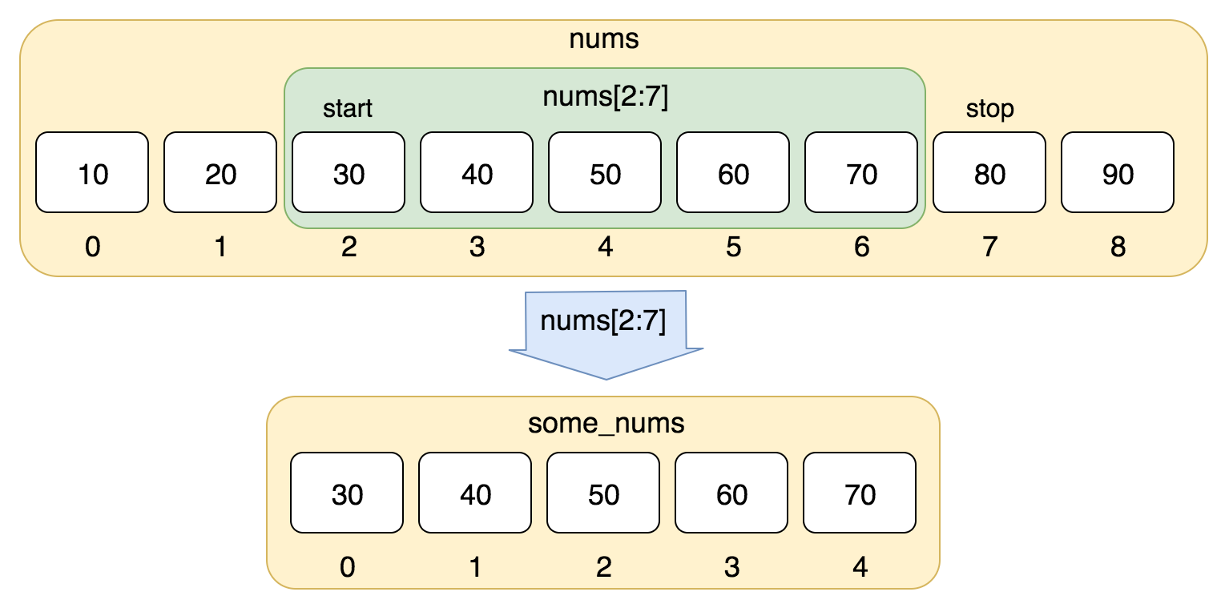
Slicing
Array slices are views on the original array
Format
start: end: step

Slide 12
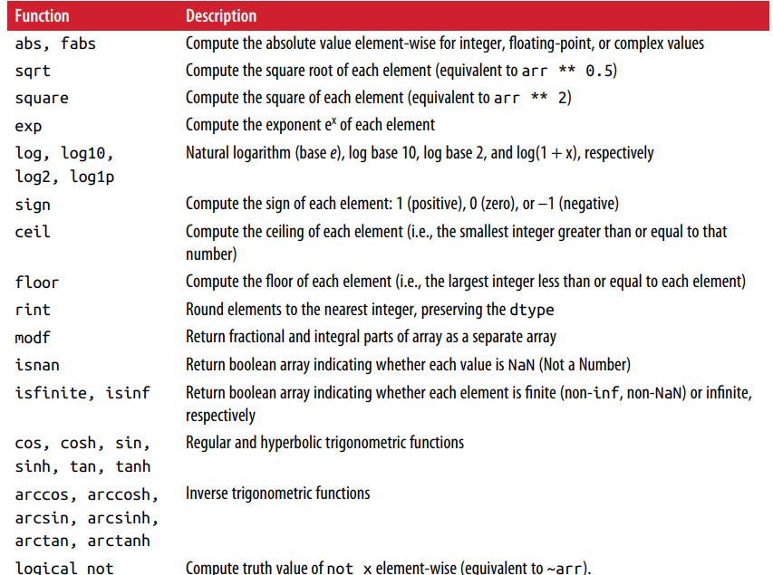
Element-wise array functions

Slide 13
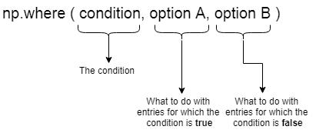
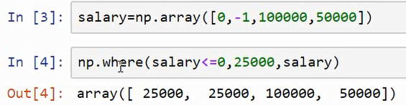
np.where()

Slide 14
Mathematical and Statistical Methods
mean(): returns the mean value computed over the array
cumsum(): returns the cumulative sum of array elements
cumprod(): returns the cumulative product of array elements

Slide 15
Methods for boolean arrays
sum(): counting True values in a boolean array
any(): tests whether one or more values in an array is True
all(): checks if every value is True

Slide 16
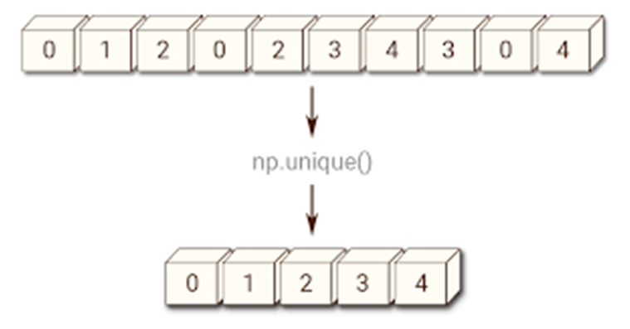
Unique

Slide 17
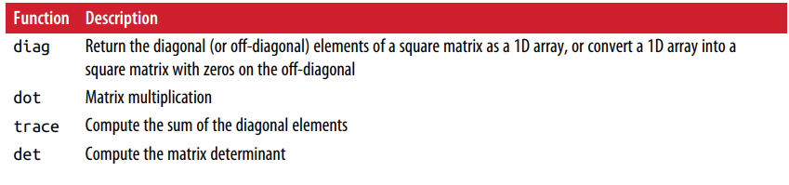
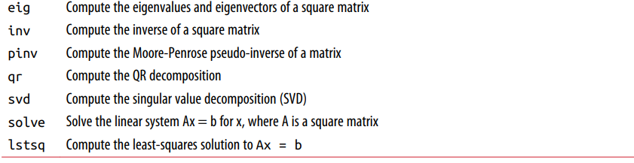
Linear algebra functions

Slide 18
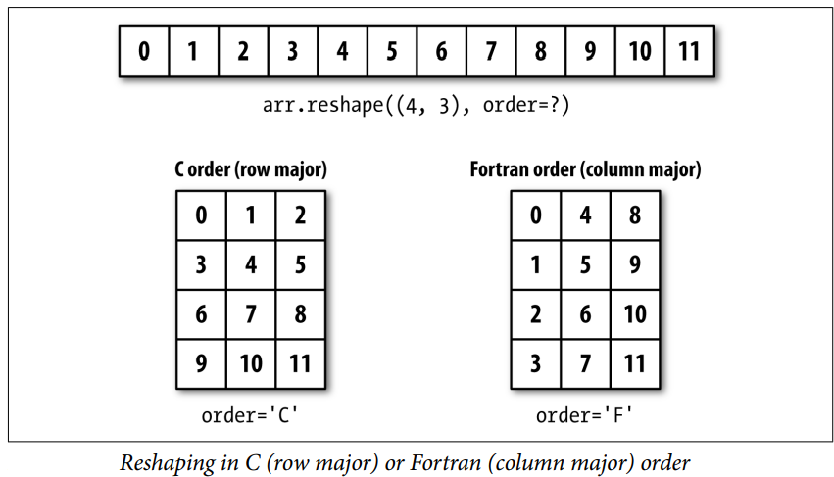
Reshape

Slide 19
Converting to 1D array
flatten()
ravel()

Slide 20
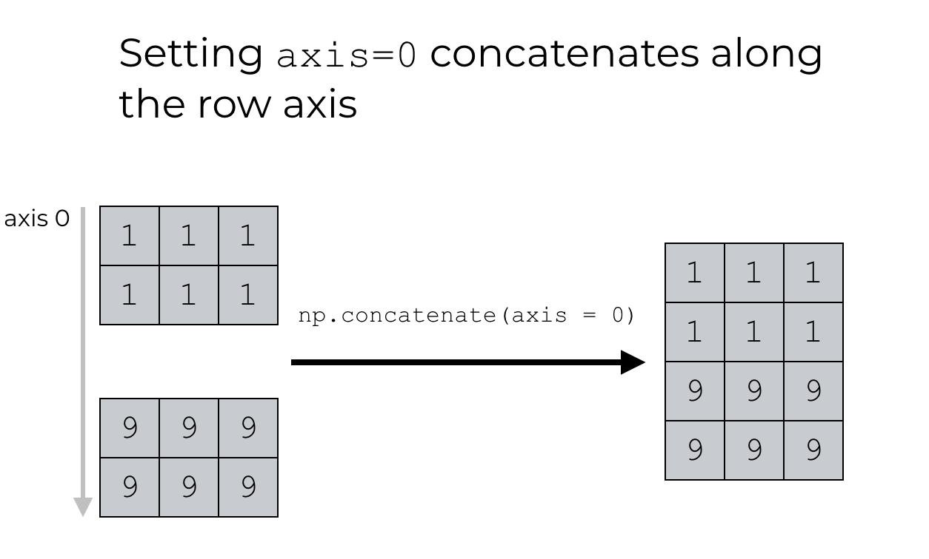
concatenate

Slide 21
Convenience functions
vstack: stack arrays row-wise (along axis 0)
hstack: stack arrays column-wise (along axis 1)

Slide 22
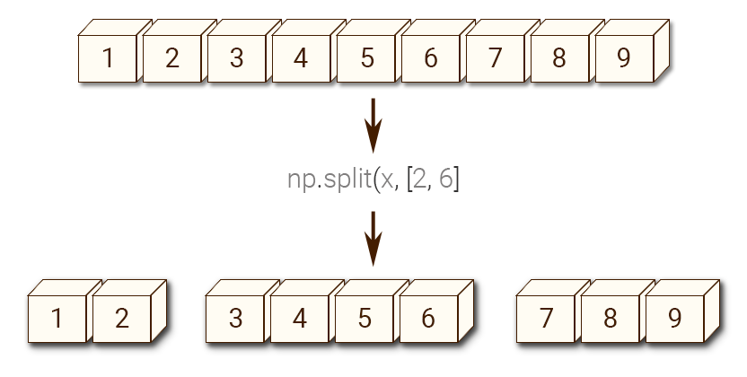
Splitting an array

